Slide 1
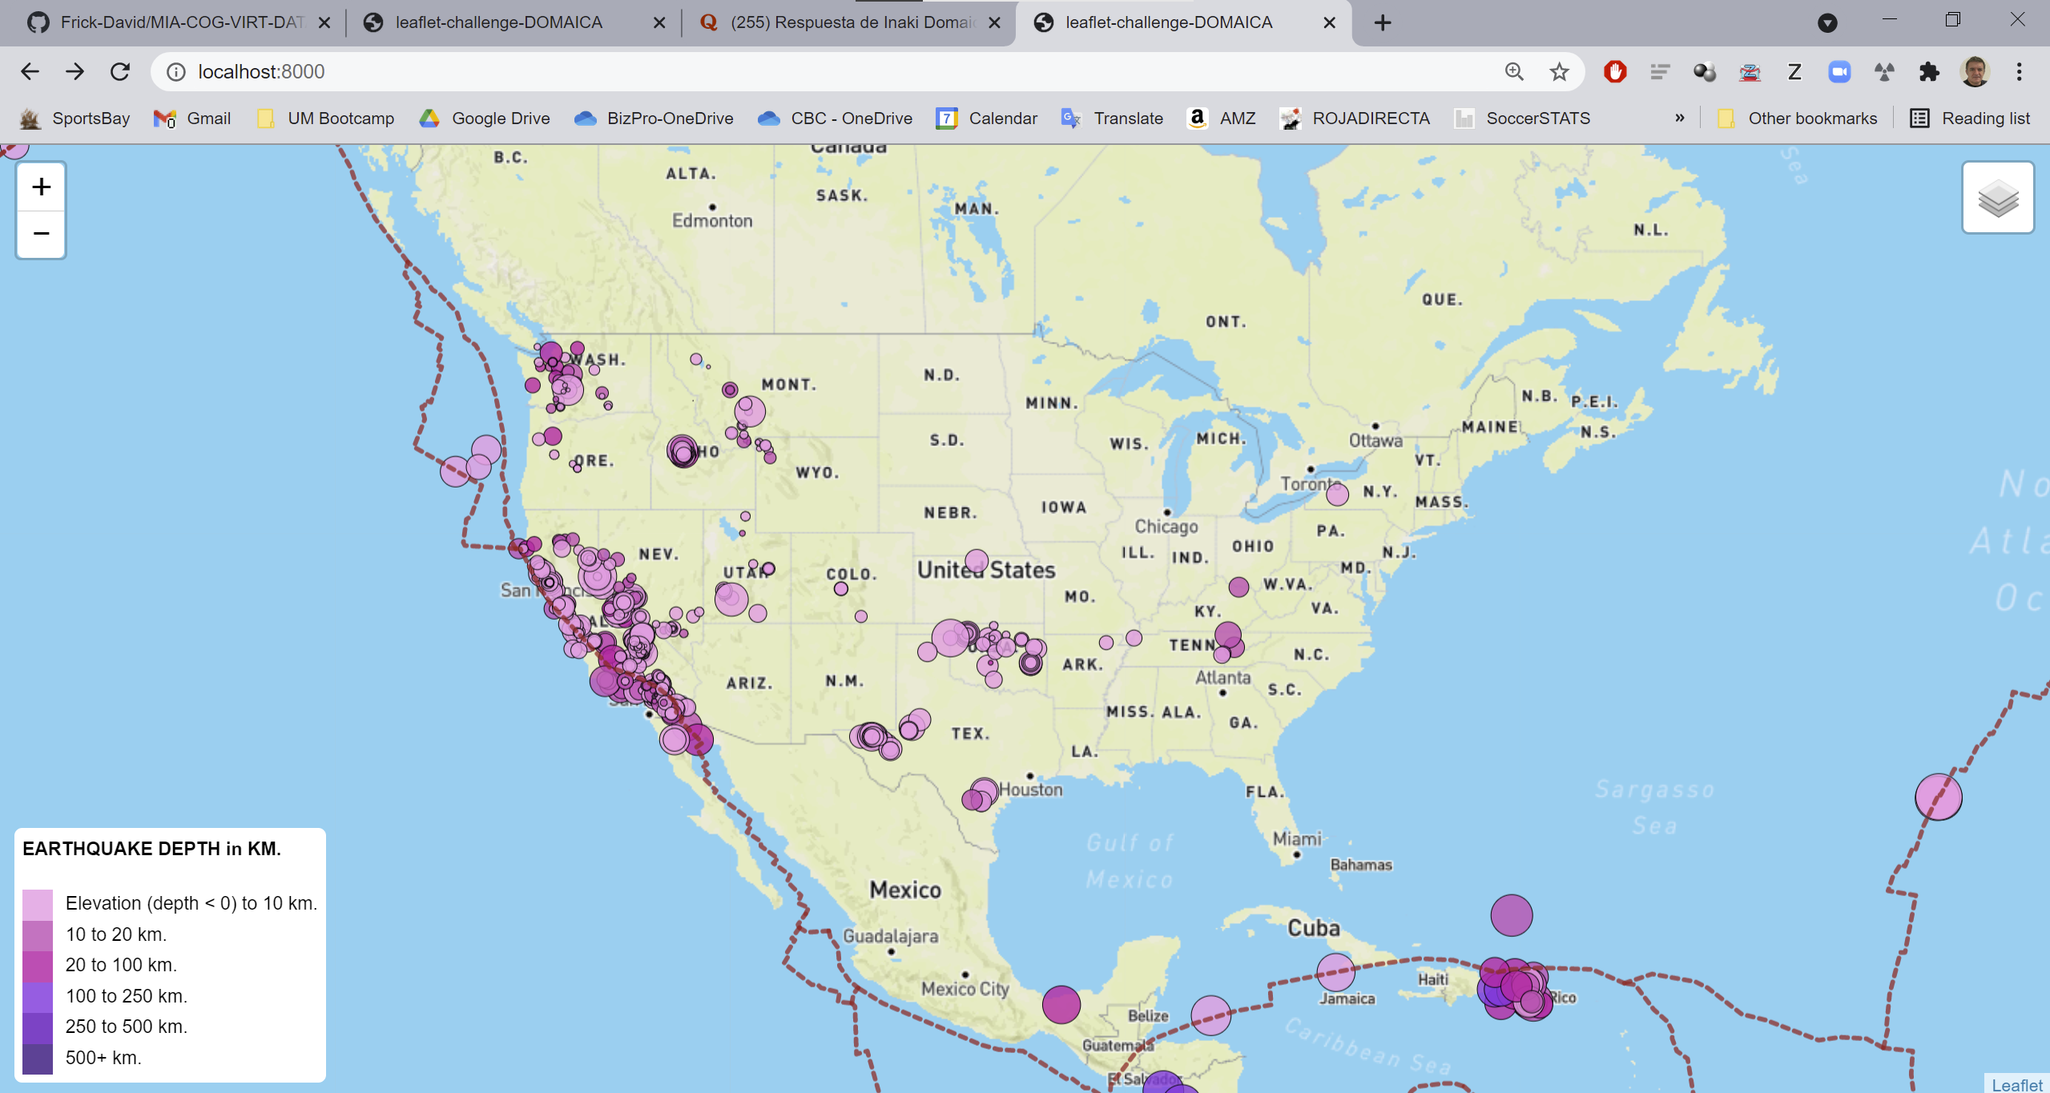
Index.html. Detail of index.html webpage

Slide 2
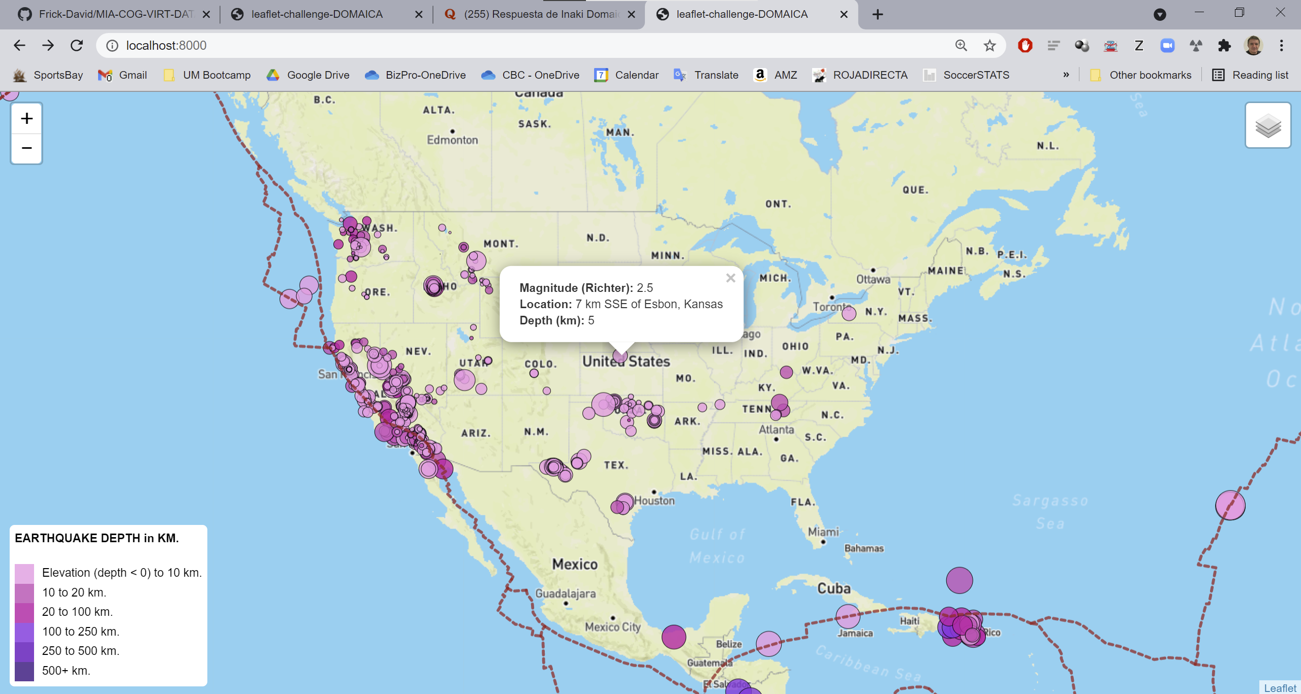
Detail of legend with “Depth”. Color according to “Depth”

Slide 3
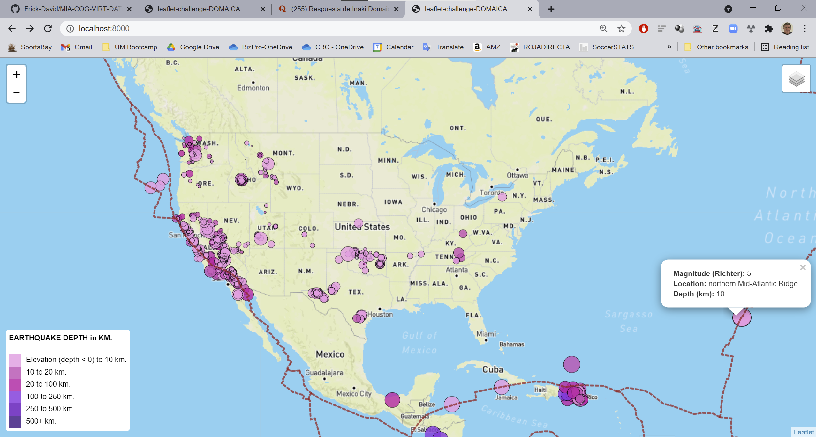
Marker size according to earthquake magnitude

Slide 4
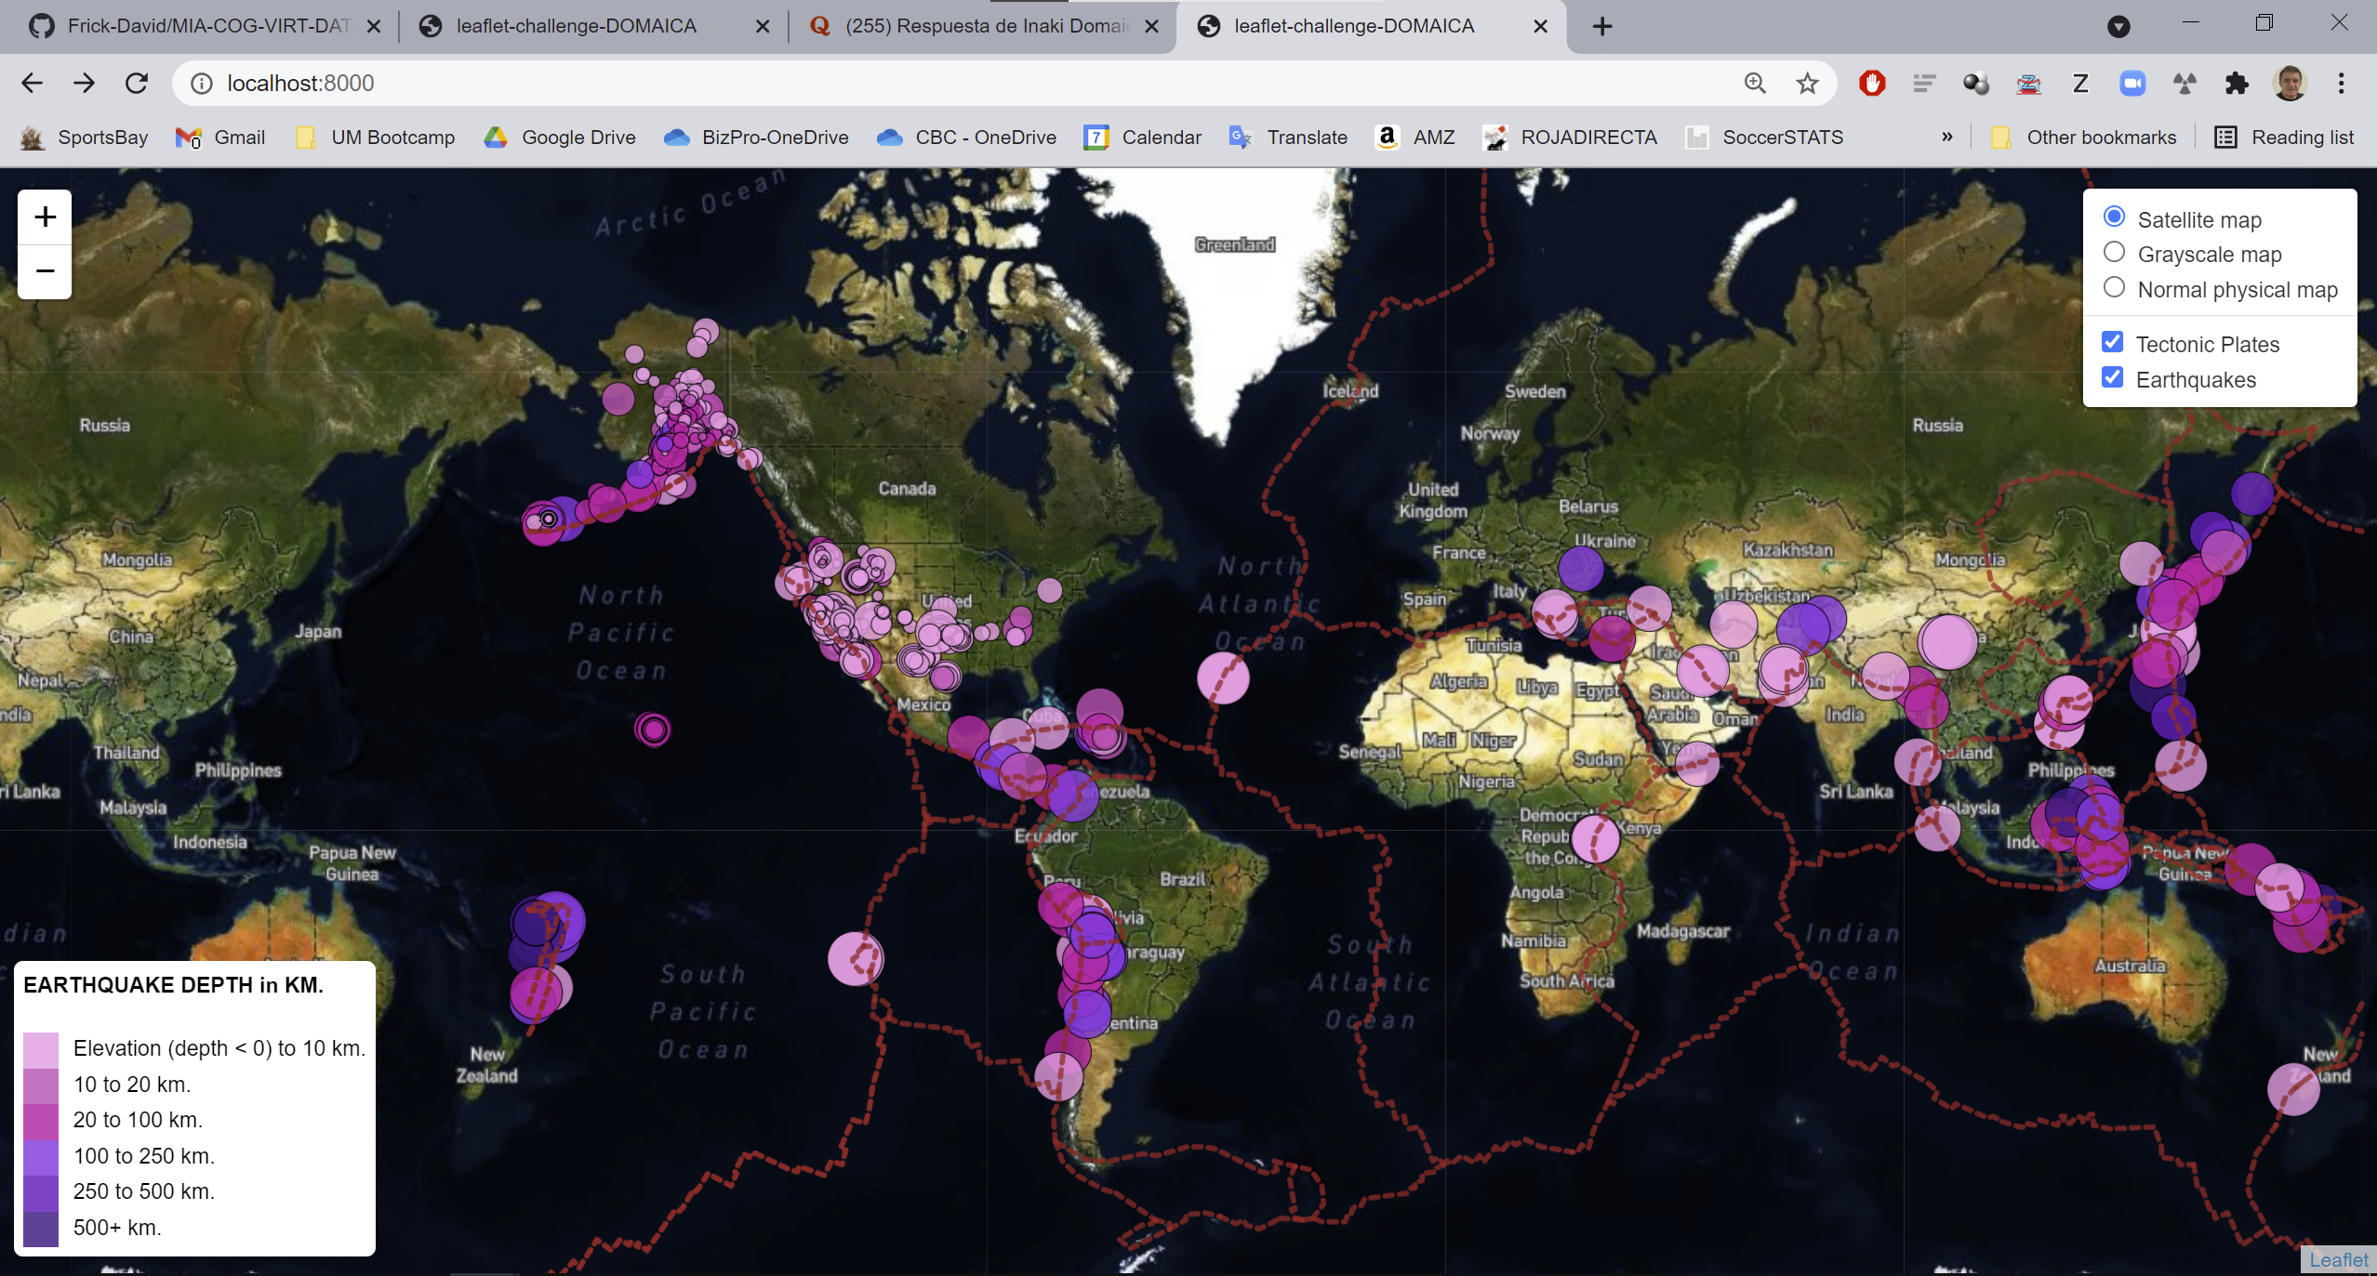
Change of basemap: Satellite

Slide 5
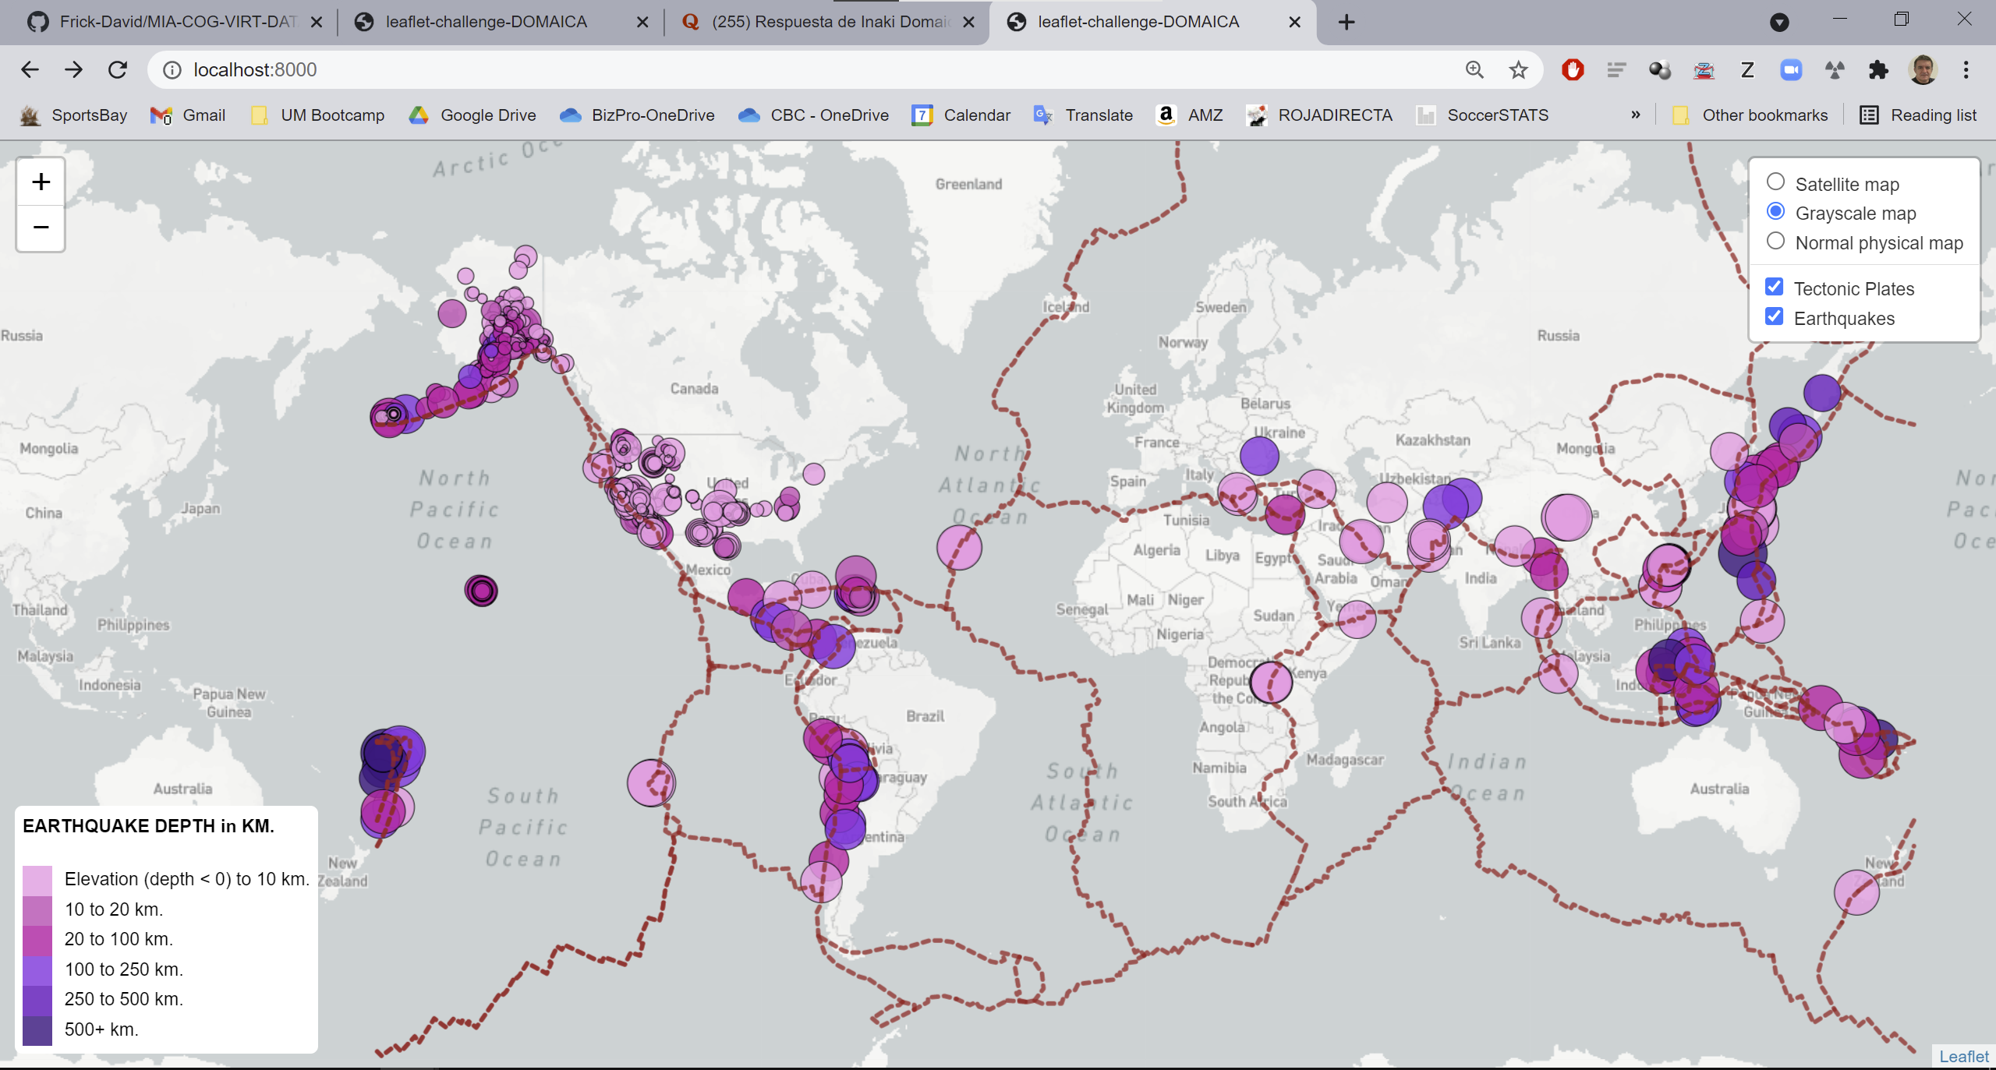
Change of basemap: Grayscale

Slide 6
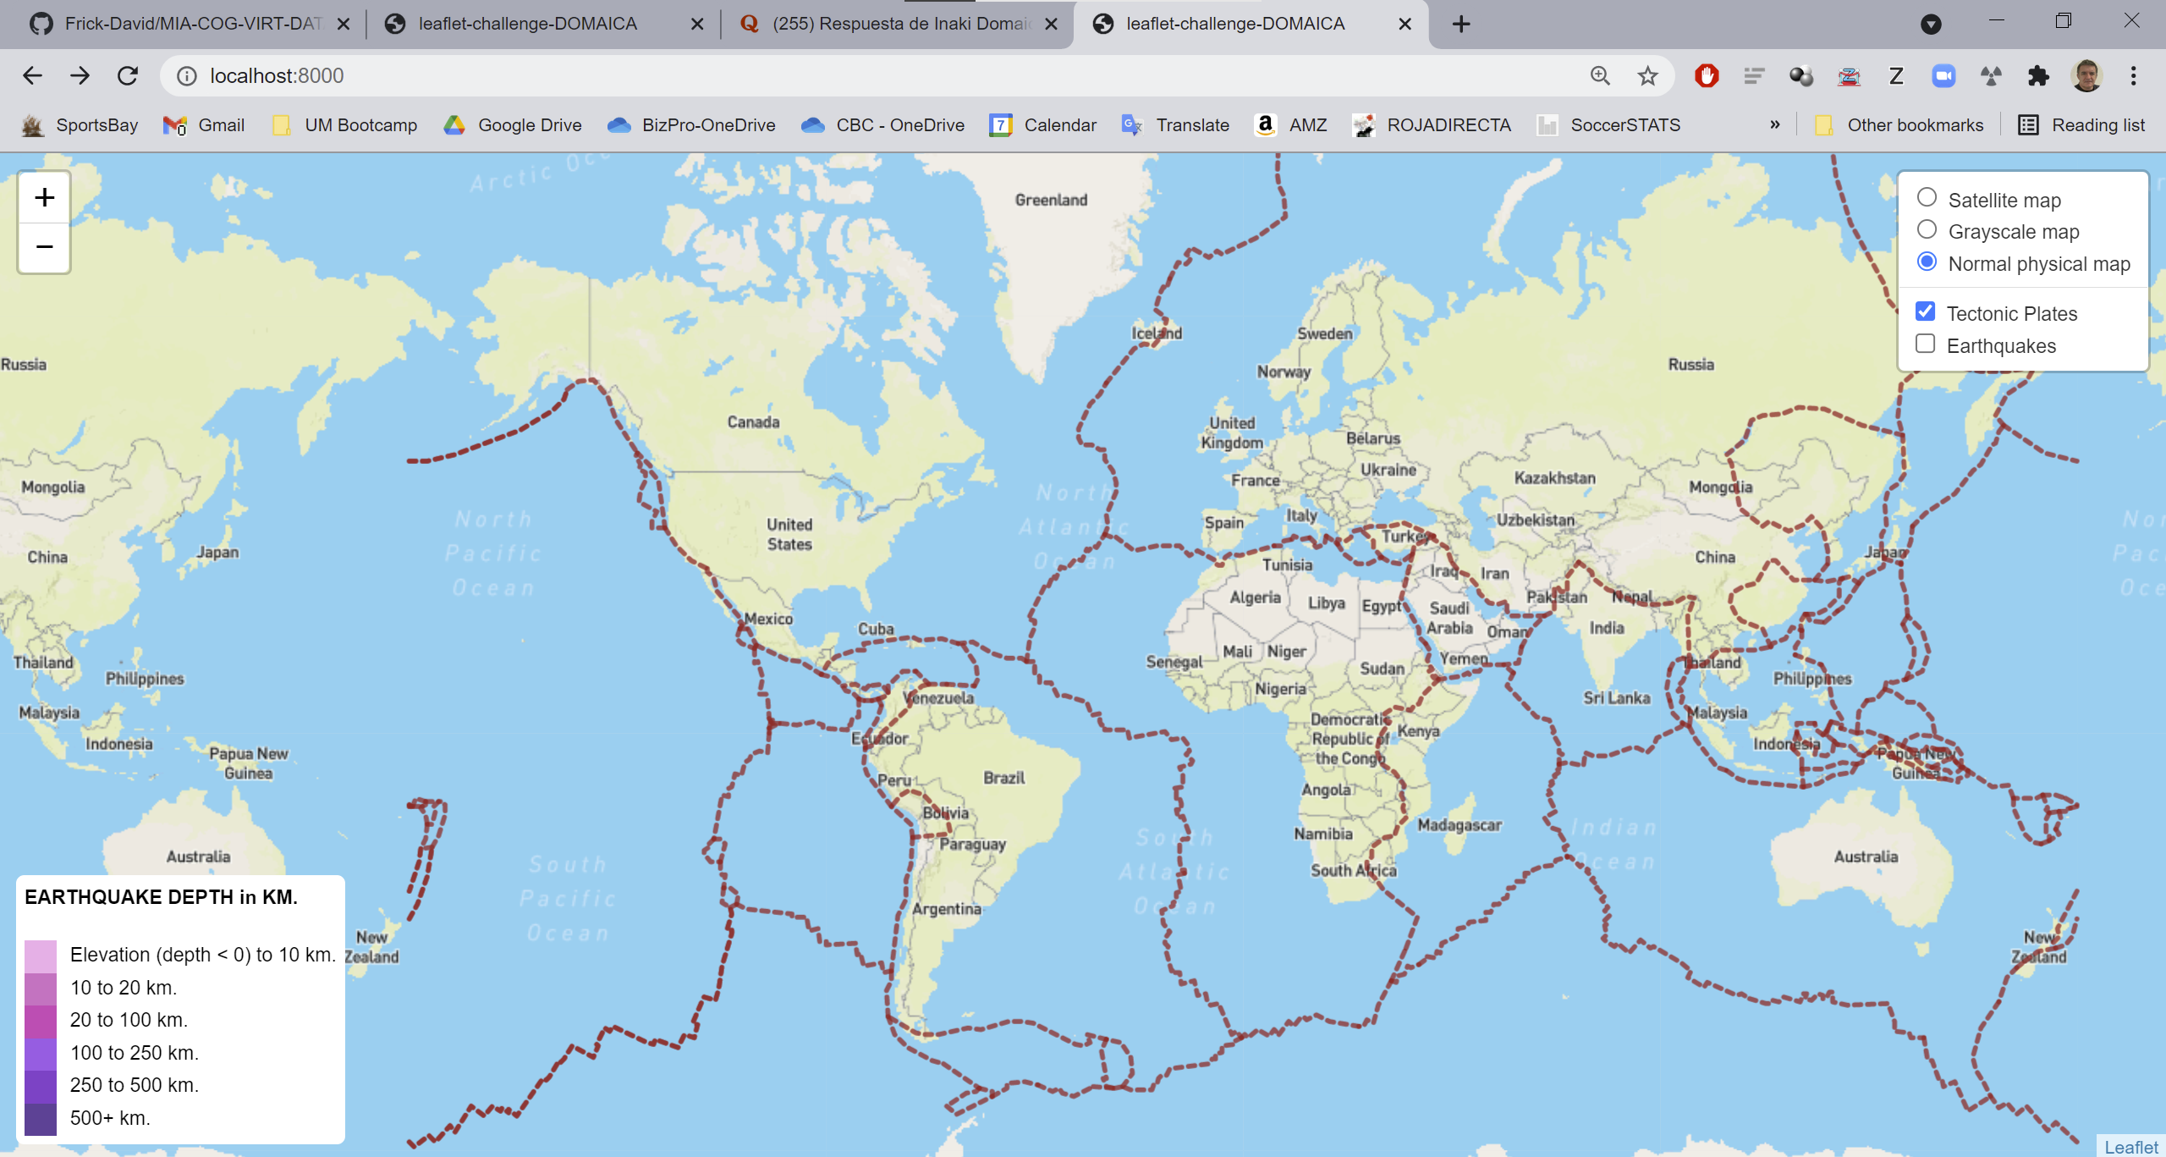
Showing only layer with tectonic plates

Slide 7
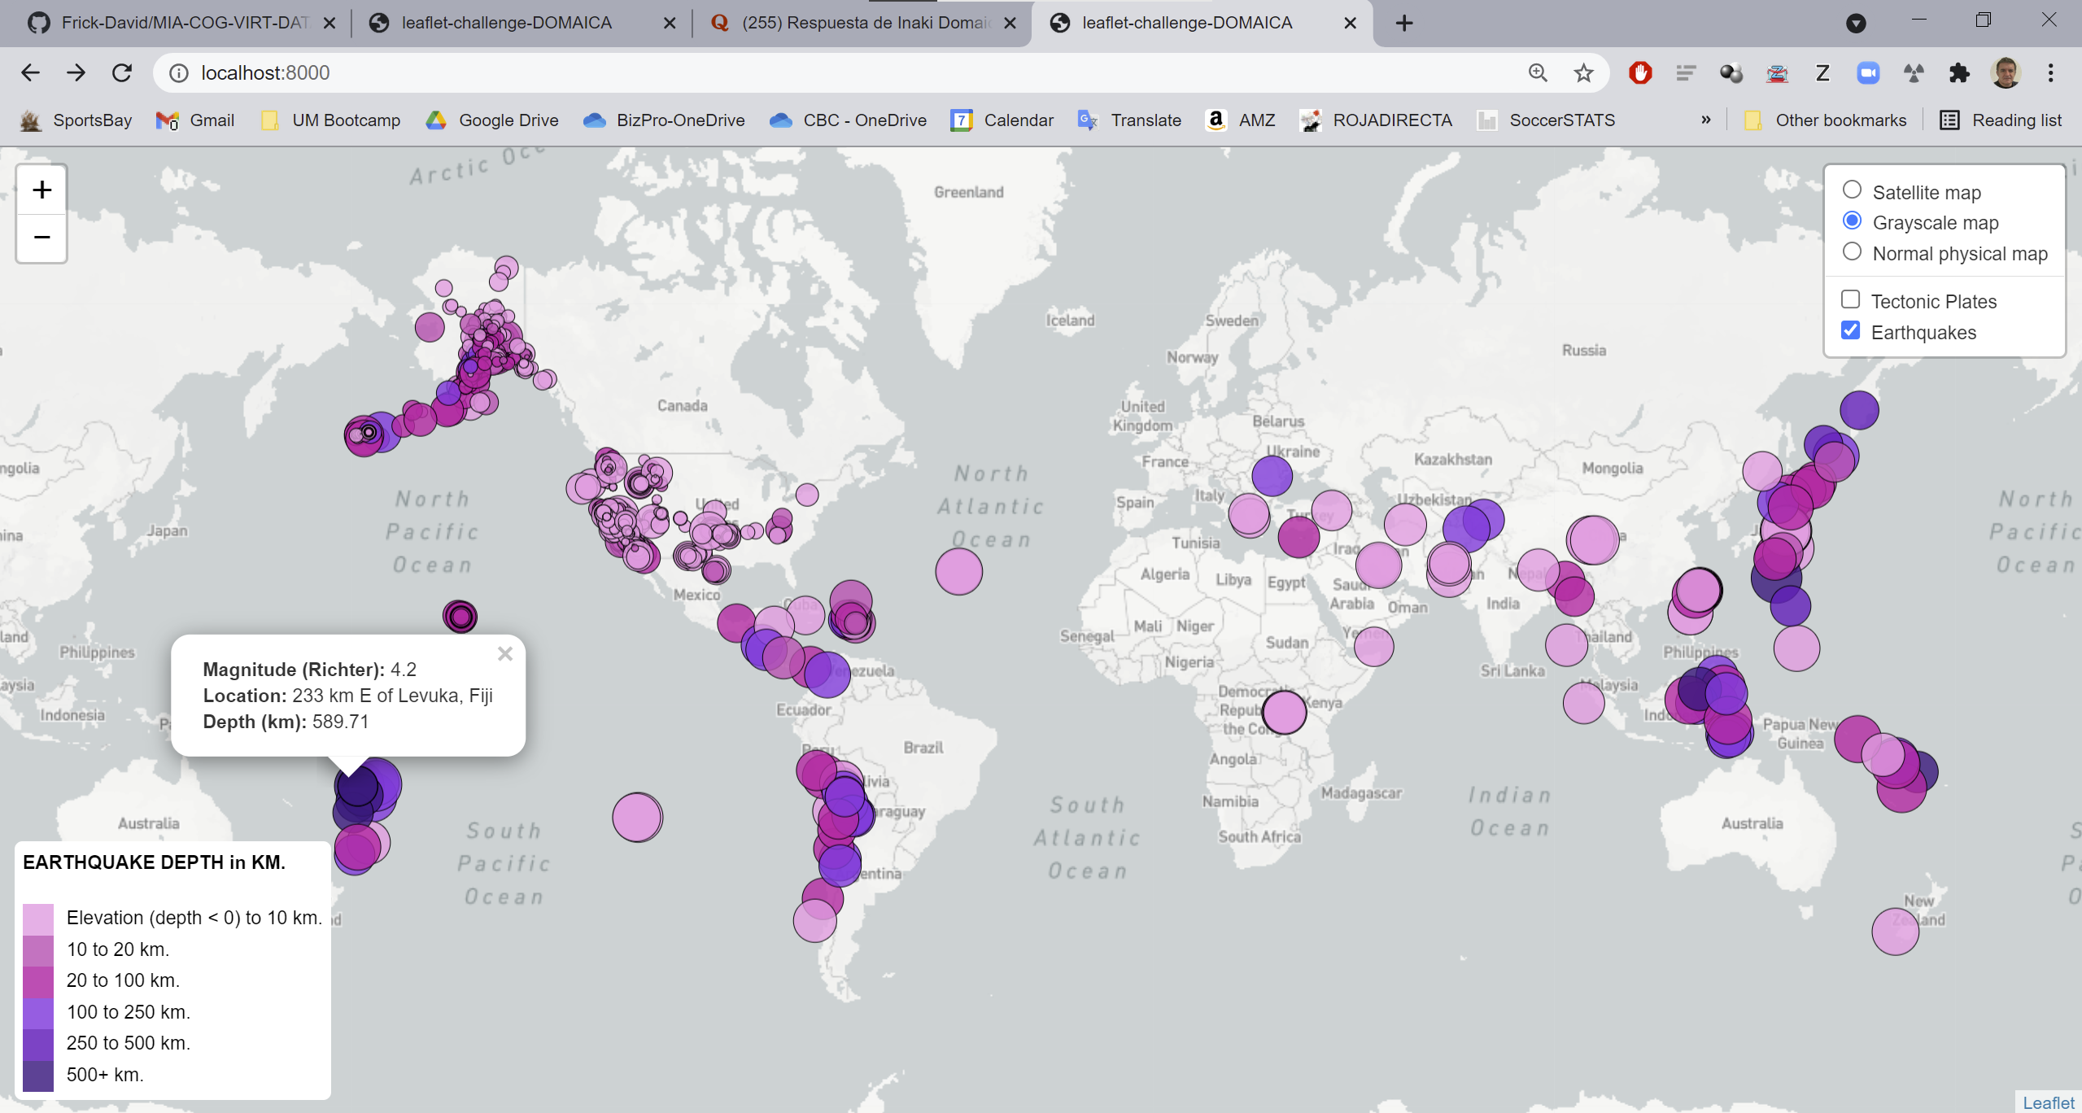
Showing only layer with earthquakes over grayscale map and detail of a deep earthquake

